Slide 1

Machine Learning Applications for Predicting Molecular Structures
COSC320 – Group B

Slide 2
Project Members
Team Members
Matt Ellis
mellis35@myune.edu.au
Joey Huang
chuang26@myune.edu.au
Andrew McKenzie
amcken33@myune.edu.au
Matt Smith
msmit328@myune.edu.au
Lyam Talbot
ltalbot6@myune.edu.au
Client
Professor Amir Karton
Professor of Chemistry and Associate Dean of Research at the University of New England.
PhD in Theoretical and Computational Chemistry.
Amir.Karton@une.edu.au

Slide 3
Project Overview
Explore machine learning (ML) models to classify molecules as in or out-of-equilibrium based on their structure.
Research and prototype a ML model to make molecular predictions using the QM9 dataset.
Model aim: Classify molecules as being in equilibrium or nonequilibrium based on their relative spatial coordinates.
Such a model could help researchers explore the complete chemical space or might point to unfound influential compounds relevant to industries such as material sciences and pharmaceuticals.

Slide 4
Project Objectives
Client Specifications:
Produce a reusable ML model with a set input structure.
Produce thorough documentation for future teams to pick up the project.
Produce a brief report on the performance and validity of the model.

Slide 5
Project Plan vs Execution
Project Scope Change/s:
Replaced the aim of generating stable molecular structures with the aim of classifying molecular structures as being in equilibrium or not.
This was due to time and technical constraints.
Data Feature Addition:
The addition of calculating and including the molecules HOMO-LUMO energy gaps came about later in the project, this was a very welcoming addition to the model, giving it more features to learn from.
This addition resulted in a slight rebound in accuracy after it dropped when we decreased the displacement distance.

Slide 6
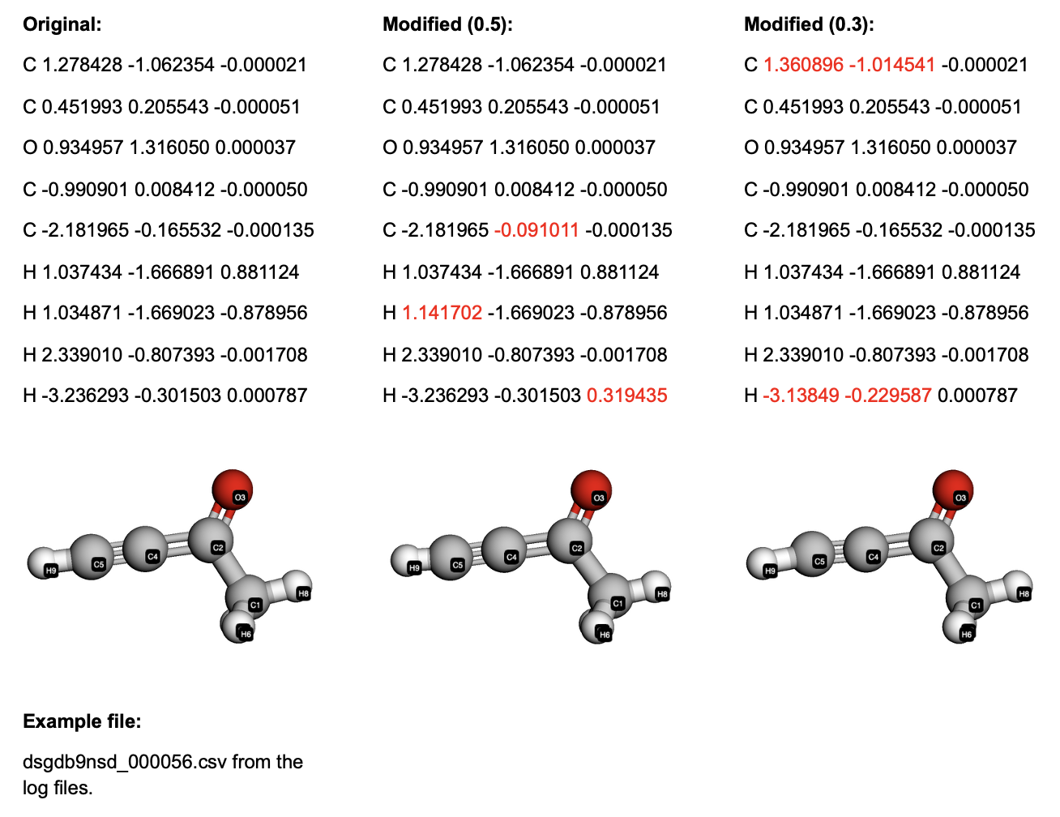
Data Training and Evaluation
The model was trained on an equal number of equilibrium and nonequilibrium molecules with the latter having a total displacement of 0.3 Angstroms.
The model was then tested against two datasets, both with the same amount of equilibrium and nonequilibrium molecules but with 0.3 and 0.5 Angstroms of displacement to evaluate any performance difference.

Slide 7
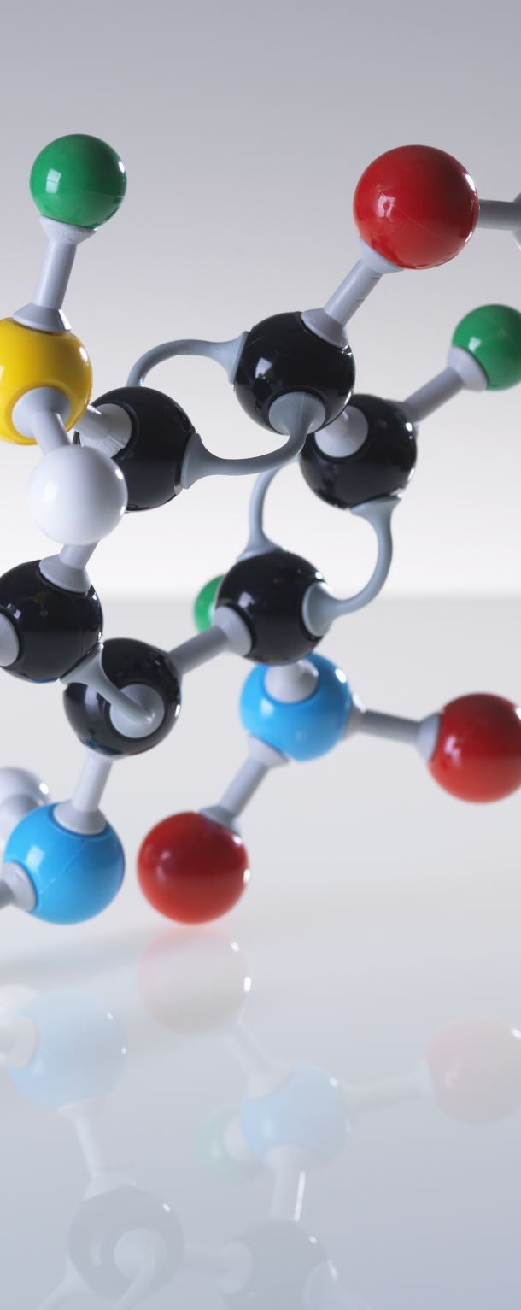
Project Outcomes
Implemented and trained a Graph Neural Network (GNN) on a subset of the QM9 Dataset.
Classifies whether molecules are in equilibrium with approximately 81% accuracy on test data.
Produced a Python program for running predictions on files.
Takes as input a simple csv format of atoms and their spatial coordinates.
Outputs a classification prediction and it’s confidence as a percentage.
Delivered a well-documented workflow for future developers to continue the project.
This contains two thoroughly commented Jupyter notebooks with many justifications covering our choices.
Plus, multiple scripts for managing data throughout the workflow.

Slide 8
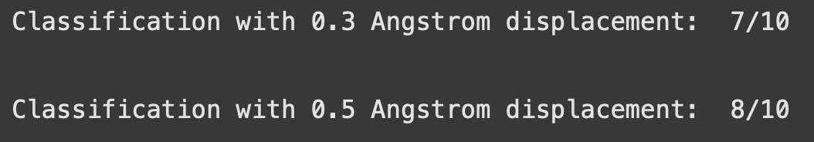
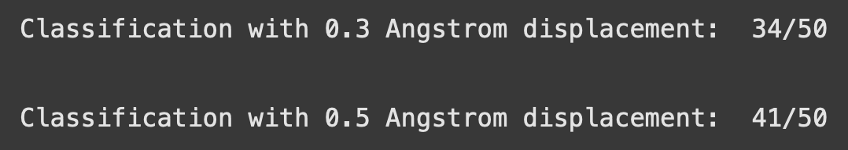
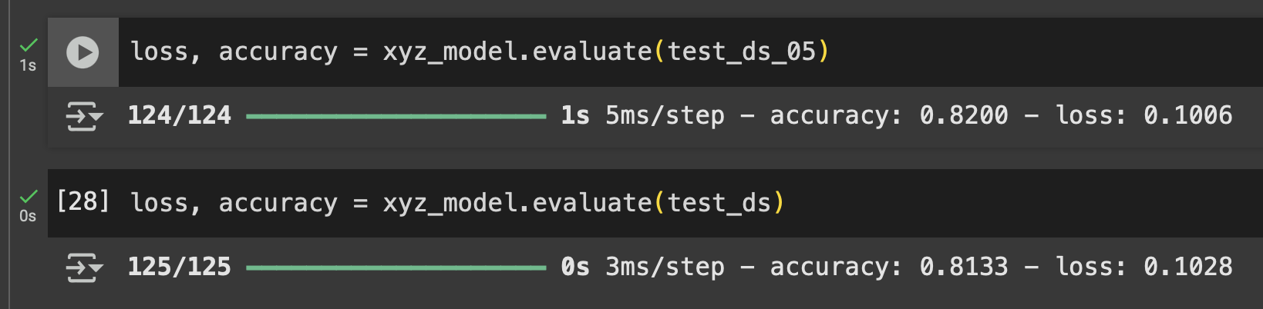
Model Accuracy
Comparing the two test sets over a different quantity of samples, the convergence to the ~81% becomes clear.
Predicting across 10 samples
Predicting across 50 samples
Evaluating against the entire test dataset
125 batches * 32 samples per batch = 4000 samples

Slide 9
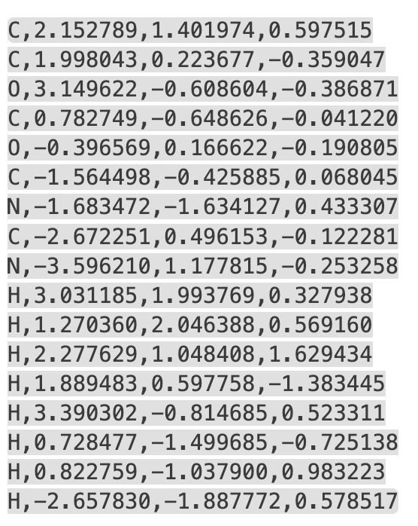
Jupyter Notebook 1– Create Dataset
qm9_create_tfdataset.ipynb
Takes in two directories of CSV files
Energy gap, atom types, coordinates
Processes the dataset
Parses all csv files extracting atoms, coords, energy gap.
Encodes the character labels as integers.
Pads all molecules to the same size, creates a mask for identifying the real molecules.
Creates an adjacency list of connected atoms.
Saves molecule data and features as a TensorFlow dataset ready for training.

Slide 10
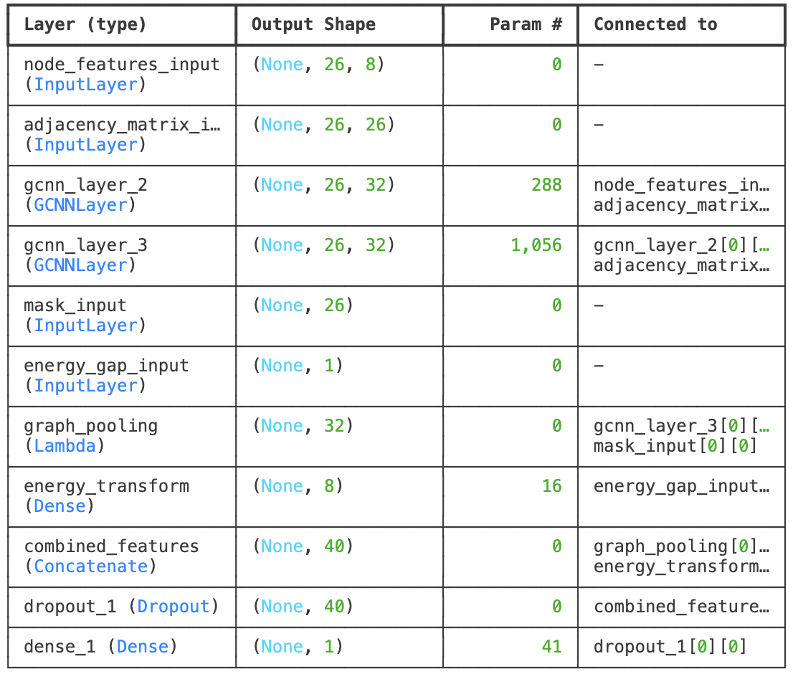
Jupyter Notebook 2 – Model Training
xyz_training_model.ipynb
Takes as input, the datasets from the previous notebook.
Splits the training dataset into 80% for training and 20% for validation.
Declares callbacks for training.
Early Stopping.
Model Checkpoint.
Builds the model layers.
Compiles the model
Loss – BinaryFocalCrossentropy
Metrics - Accuracy
Evaluates performance.

Slide 11
Project Demonstration
Dataset creation notebook walkthrough.
Model training notebook walkthrough.
Client usage demonstration.

Slide 12
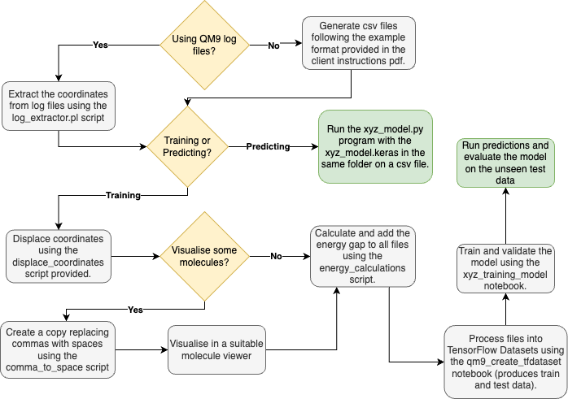
Project Usage Flow Chart

Slide 13
Project Handover
Document Name | Purpose
Client Instructions | A PDF with detailed instructions for using the project.
xyz_model.py | A Python program to load the model and run predictions.
xyz_model.keras | The trained and saved deep learning model. This needs to be kept in the same folder as the xyz_model.py file.
negative.csv and positive.csv | Example input csv files for running through the xyz_model.py program.
comma_to_space.py | Script to convert csv files to txt files for observation in a molecule viewer.
xyz_model_analysis.ipynb | A Jupyter Notebook for model performance analysis.
README.md | For future dev teams to understand the project workflow and the purpose of all documents.
xyz_training_model.ipynb | A Jupyter Notebook for model training and evaluation.
qm9_create_tfdataset.ipynb | A Jupyter Notebook to pre-process the data before training the model.
Legend
Client predictions | Optional use | Developer use | Project reports

Slide 14
Project Handover - Continued
Document Name | Purpose
log_extractor.py | Script to extract coordinates from all log files in a directory.
energy_calculations.py | Script to calculate the HOMO-LUMO energy gap.
displace_coordinates.py | Script to generate nonequilibrium molecules.
log_script_single.pl | The script provided to us by Amir Karton to extract coordinates from QM9 log files.
qm9_tensorflow_datasets | A folder containing pre-processed training and testing datasets for the model.
Project Presentation | The PowerPoint presentation covering this project.
Final Project Report | The final project report with useful evaluation metrics.
Legend
Client predictions | Optional use | Developer use | Project reports

Slide 15
Project Closure
All documents covered in the project handover slides have been collected into a folder and delivered to the client
The client has the contact details for the team if any questions or issues arise.
Submission of the final report and presentation will be completed after this recording.

